Slide 1
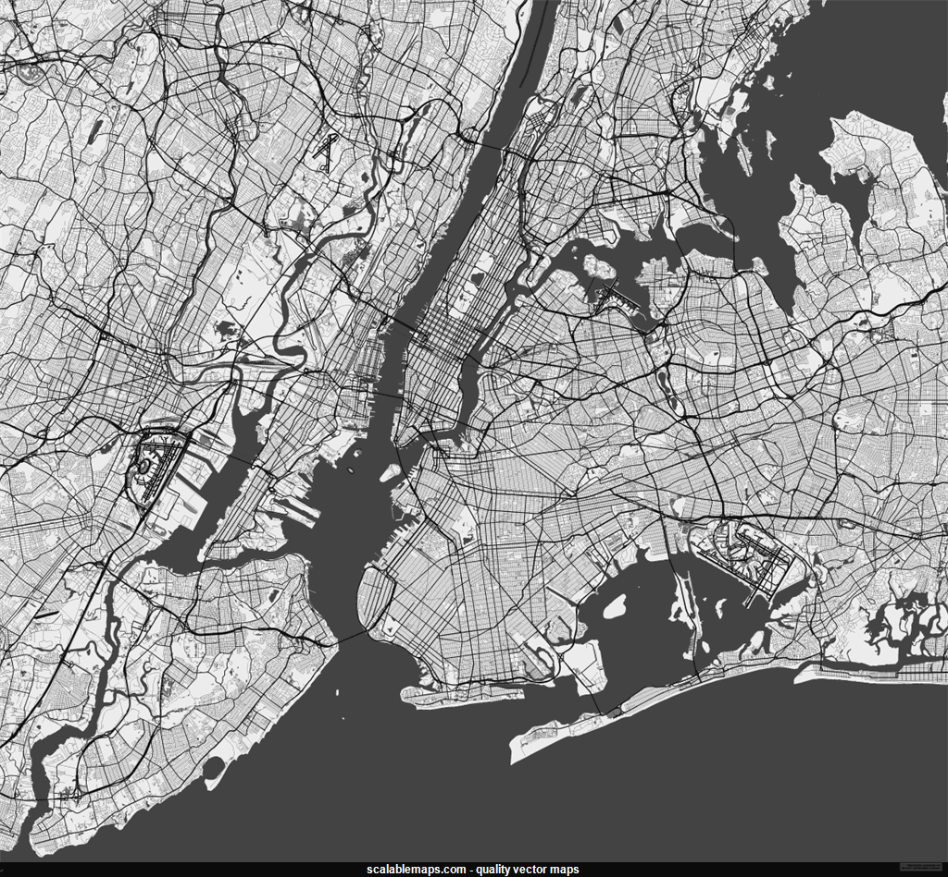

NYC AIRBNB
AN ANALYSIS ON LISTINGS FOR 2019
Ajay Acharya Kanagala, Jinee Hasmukhbh Patel, Rumana Myageri, Quyen Tuan Ngo

Slide 2
DATA DESCRIPTION
The dataset consists of Airbnb listing for NYC, for the year 2019.
It has 48895 observations of 16 variables.
We will be exploring and analyzing the data to determine any relationships between pricing and the other variables like geographic location, seasonality and online reviews.
The purpose of this study is to develop a data driven statistical model for host pricing strategies.

Slide 3
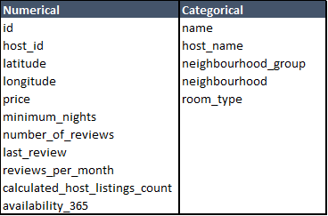
EXPLORATORY DATA ANALYSIS
The dataset contains information on the hosts, locations, reviews, prices and features of the listings.
It contains 11 numerical and 5 categorical variables.
It has 48895 observations of 16 variables.

Slide 4
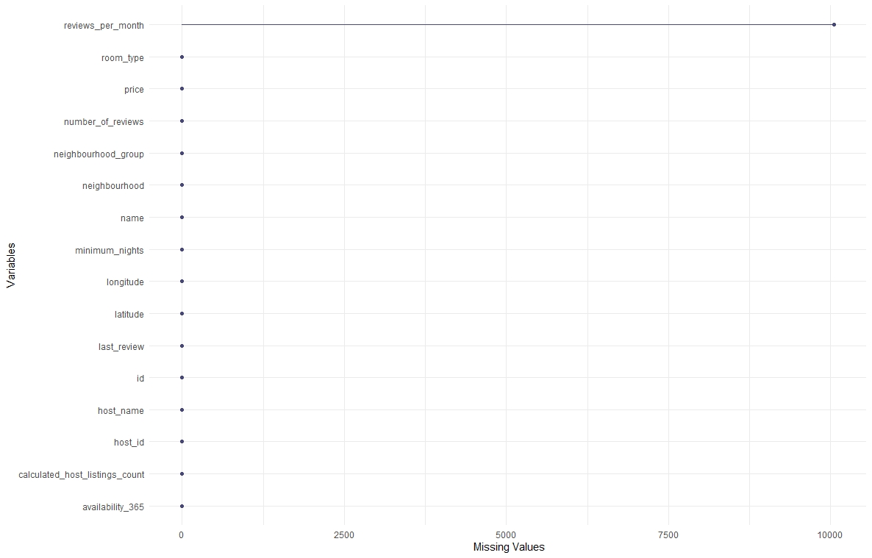
EXPLORATORY DATA ANALYSIS
MISSING VALUES

Slide 5
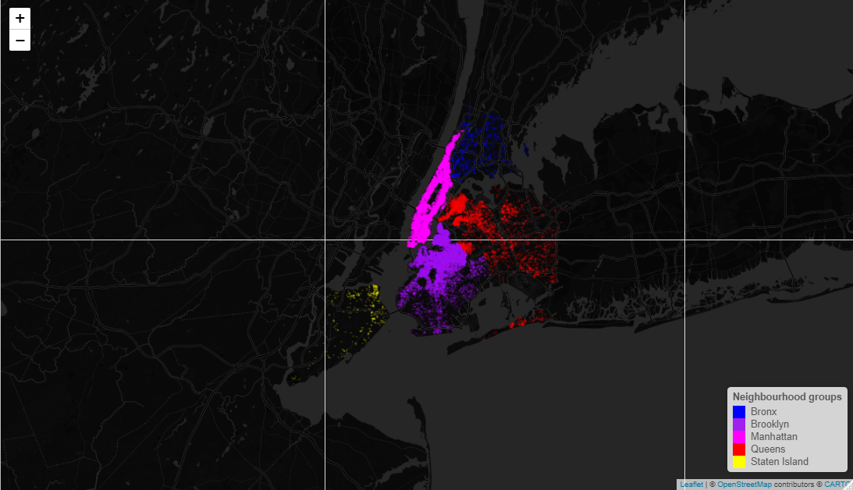
EXPLORATORY DATA ANALYSIS
DENSITY OF LISTINGS BY NEIGHBOURHOOD GROUPS

Slide 6
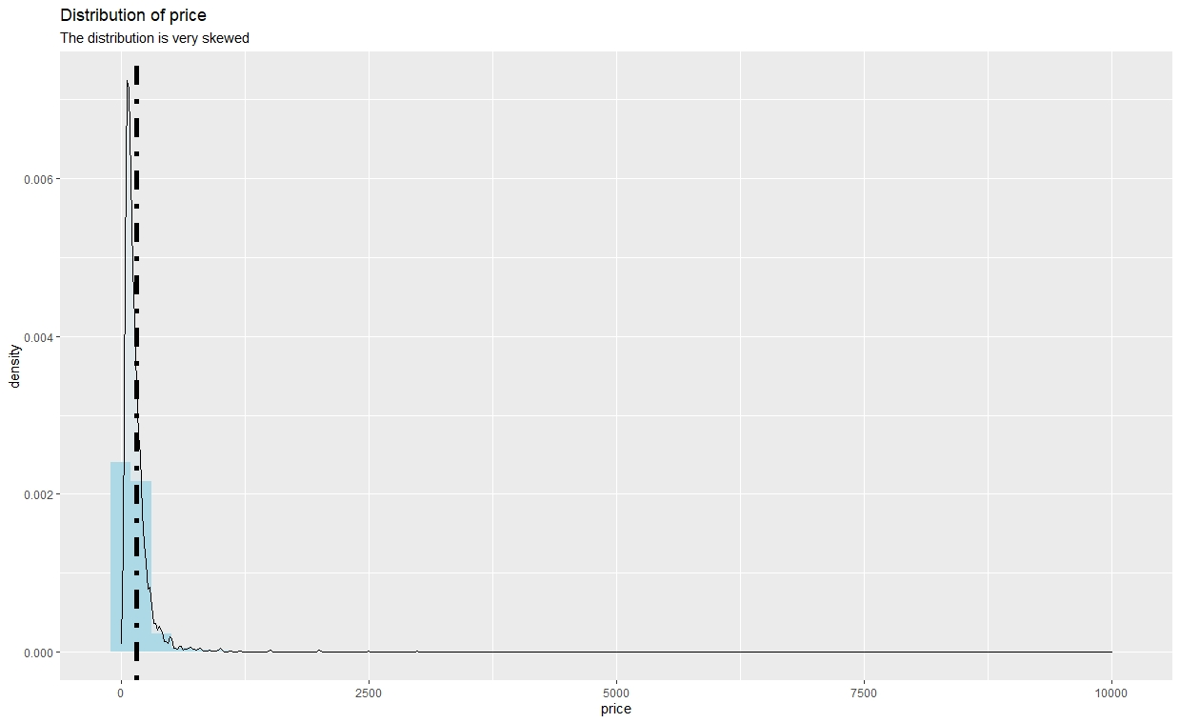
EXPLORATORY DATA ANALYSIS
PRICE DISTRIBUTION VISUALIZATION USING GGPLOT

Slide 7
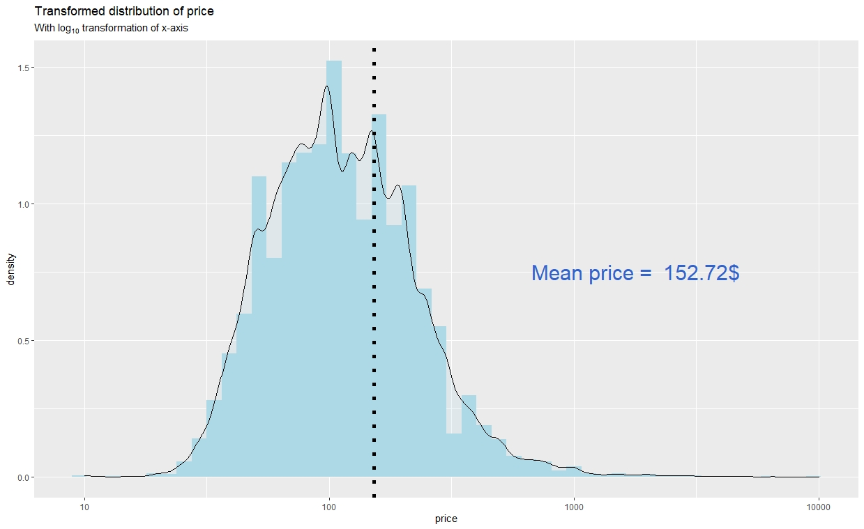
EXPLORATORY DATA ANALYSIS
TRANSFORMED DISTRIBUTION OF THE DATA

Slide 8
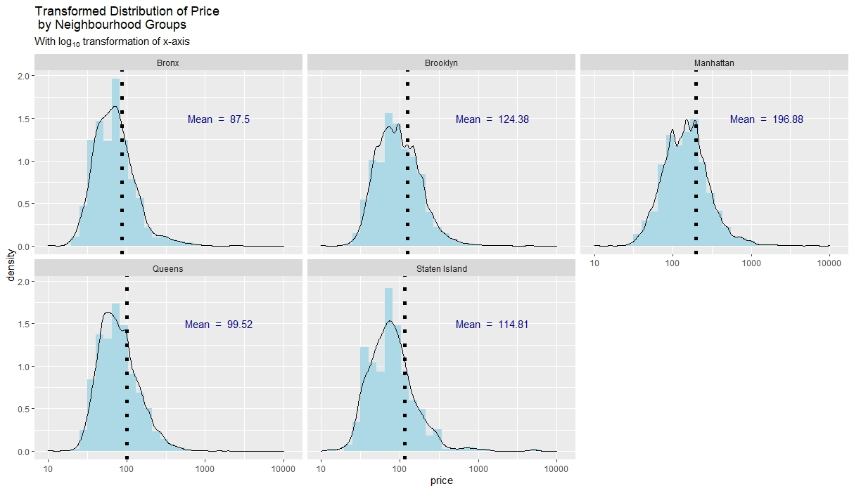
EXPLORATORY DATA ANALYSIS
TRANSFORMED DISTRIBUTION OF PRICE FOR EVERY NEIGHBOURHOOD

Slide 9
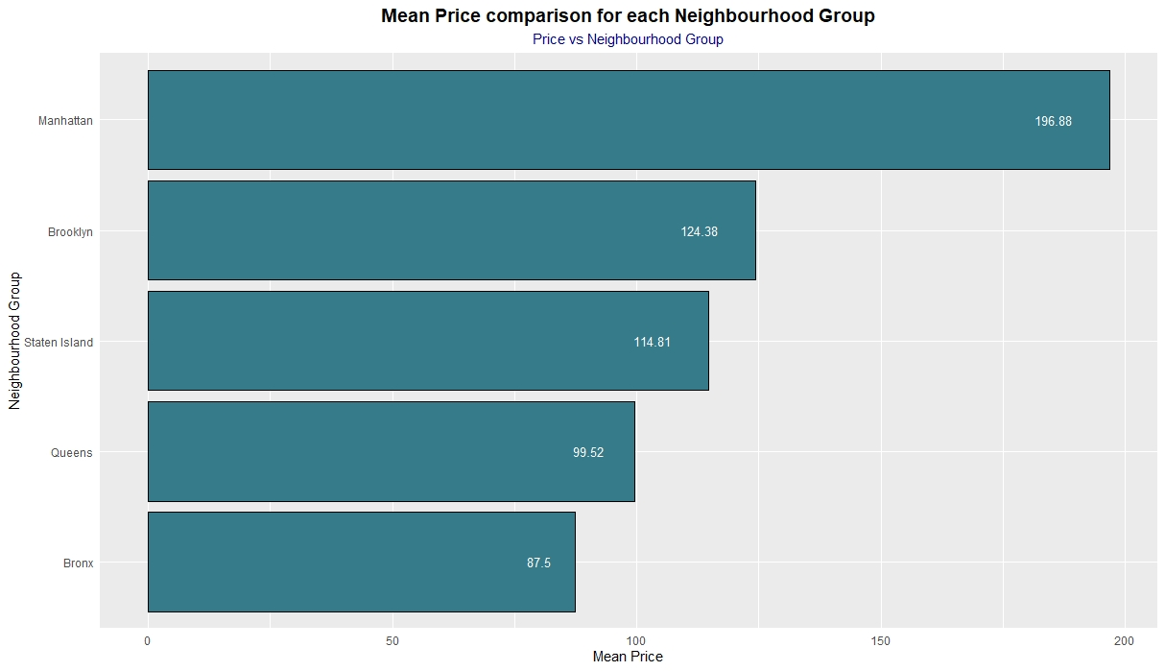
EXPLORATORY DATA ANALYSIS
TAKING ANOTHER LOOK AT THE MEAN PRICES PER NEIGHBOURHOOD GROUP

Slide 10
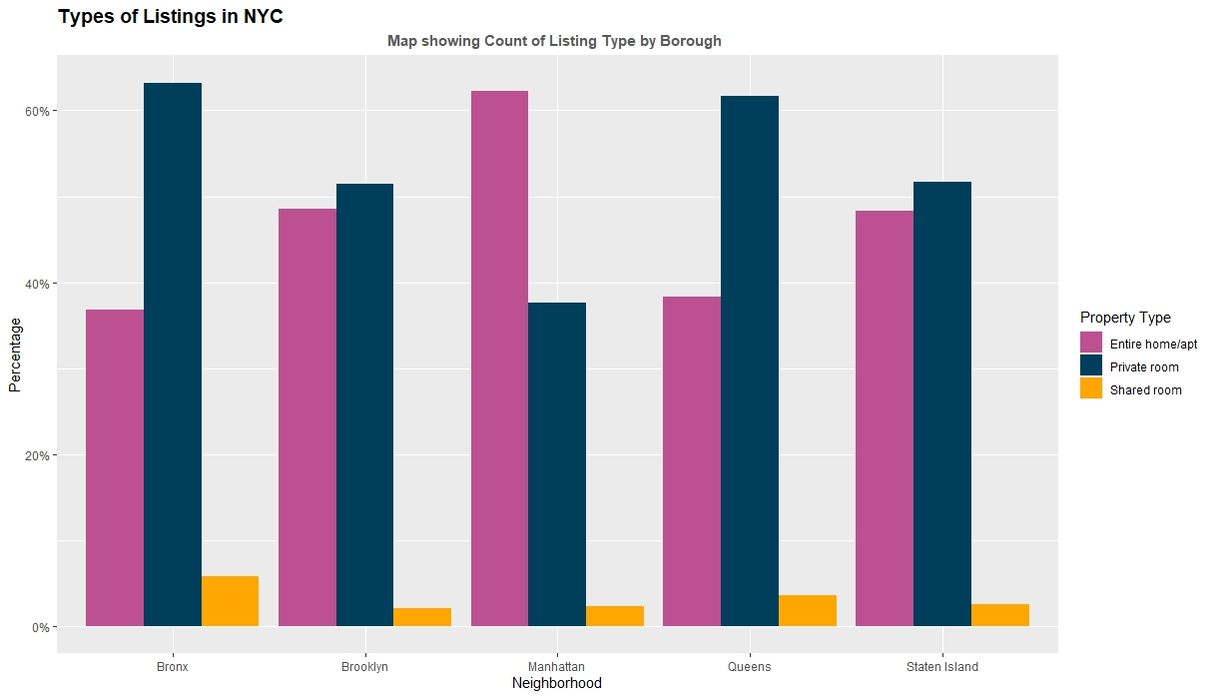
EXPLORATORY DATA ANALYSIS
TYPES OF LISTINGS BY NEIGHBOURHOOD BROUP

Slide 11
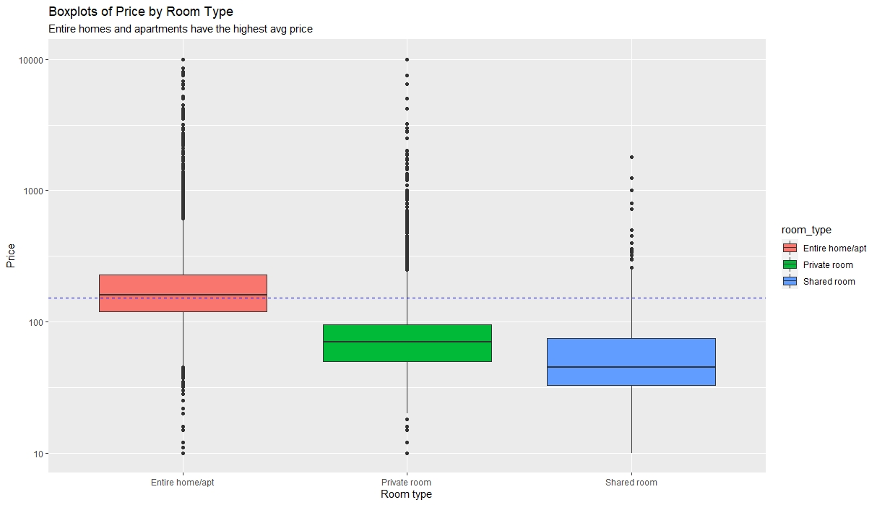
EXPLORATORY DATA ANALYSIS
PRICE BY ROOM TYPE

Slide 12
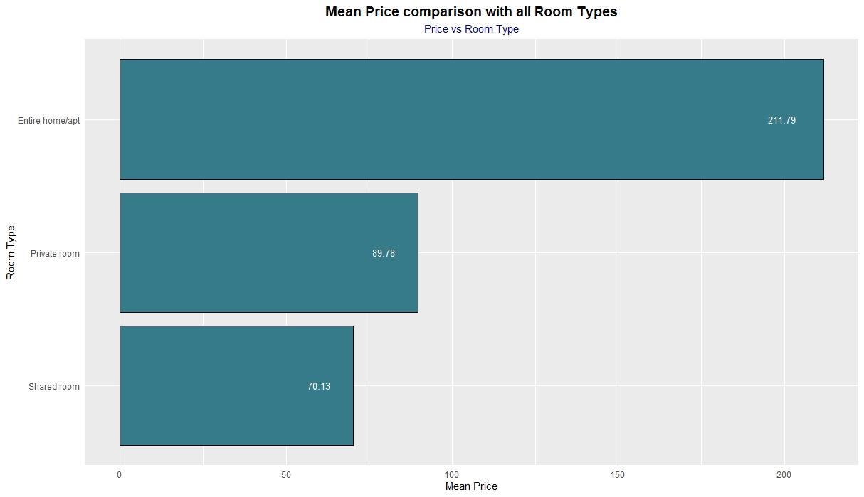
EXPLORATORY DATA ANALYSIS
PRICE BY ROOM TYPE

Slide 13
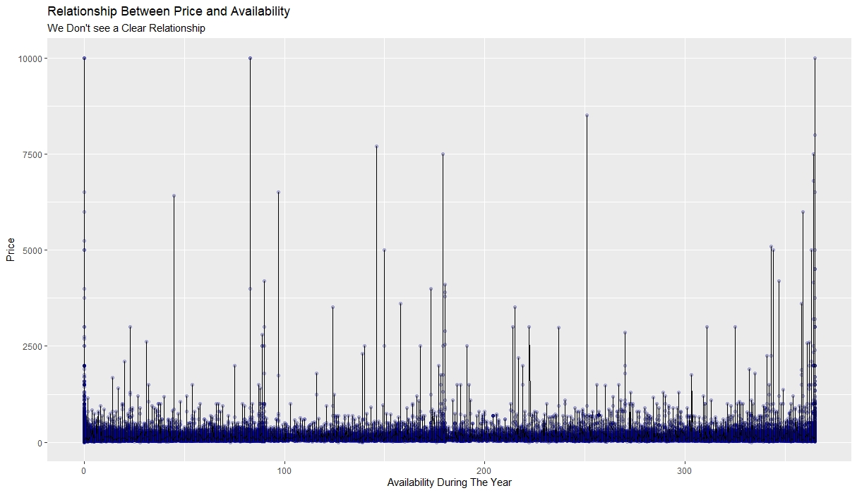
EXPLORATORY DATA ANALYSIS
RELATIONSHIP BETWEEN PRICE AND AVAILABILITY

Slide 14
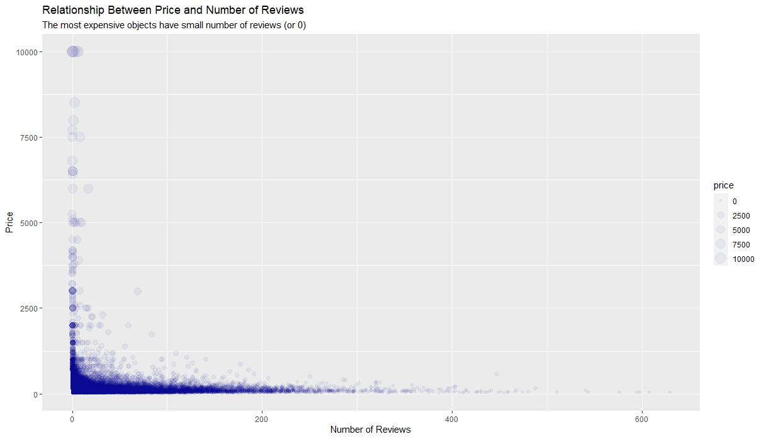
EXPLORATORY DATA ANALYSIS
RELATIONSHIP BETWEEN PRICE AND REVIEWS

Slide 15
INFERENCE
Setting up a research hypothesis to test the relationship between price and room types.
Null Hypothesis: There is NO statistical difference between price for Entire home/apt and shared room.
Alt Hypothesis: There IS statistical difference between price for Entire home/apt and shared room

Slide 16
INFERENCE
Using the inference function in R after subsetting the data into Entire Home/ shared room, we get the following statistics
The subsets have significantly different means, and CI does not overlap at all. Therefore, we reject the null Hypothesis to conclude prices are different based on room types.
 | ENTIRE HOME/ APT | SHARED ROOM
Mean | 211.7942 | 70.1276
SD | 284.0416 | 101.7253
n | 25409 | 1160
SE | 1.7819 | 2.9868
CI | 208.3017, 215.2867 | 64.2737, 75.9815

Slide 17
INFERENCE
Setting up a research hypothesis to test the relationship between price and Neighbourhood Types
Null: Price are indifferent statistically across neighborhoods.
Alt: There is a difference in prices for different neighborhoods.

Slide 18
INFERENCE
Using the inference function in R, we get the following statistics for mean prices.
The means vary significantly, therefore we reject the null hypothesis.
Bronx | Brooklyn | Manhattan | Queens | Staten Island
87.5 | 124.38 | 197 | 100 | 115

Slide 19
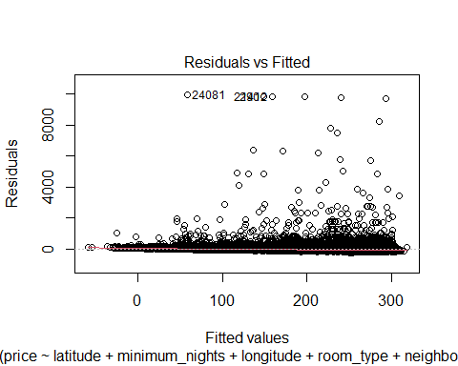
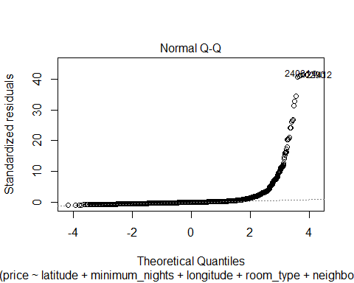
MODELING
Plots of the First Linear Regression Model:

Slide 20
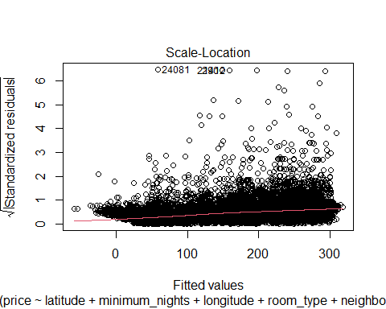
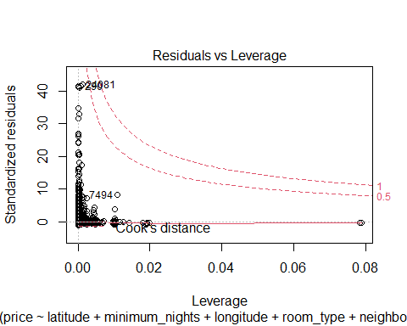
MODELING

Slide 21
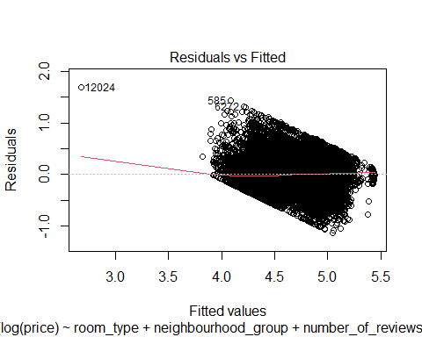
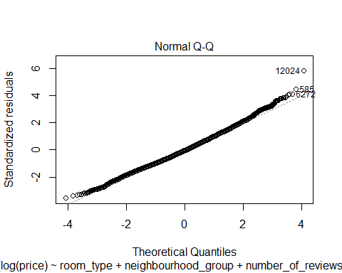
MODELING
Plots of the Second Linear Regression Model:

Slide 22
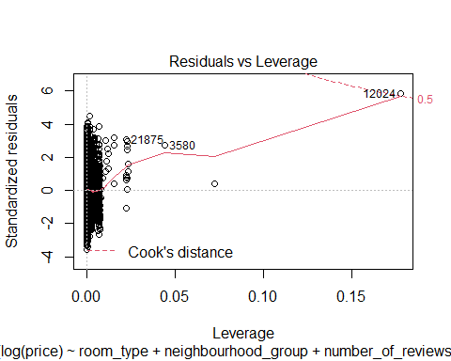
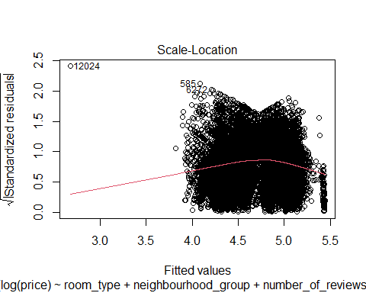
MODELING
Residuals vs fitted qualities show the specks are not equally distributed and don’t show a consistent difference around x. Therefore, linearity and fluctuation suppositions are not satisfied.
The QQ plot has a nearly straight line. Therefore, Normality presumptions are met.

Slide 23
PREDICTION
Regression Formula for Price Based on First Linear Regression Model
Y= -28550 + (-208.9 * latitude) +(0.04005 * minimum_nights) + (-503.6 * longitude) +(-104.8 * room_typePrivate)+ (-134.9 * room_typeShared )+ (-33.30 * neighbourhood_groupBrooklyn)+ (27.78 * neighbourhood_groupManhattan) + (-4.049 * neighbourhood_groupQueens) + (-162.8 * neighbourhood_groupStaten Island) + (0.1525* availability_365)

Slide 24
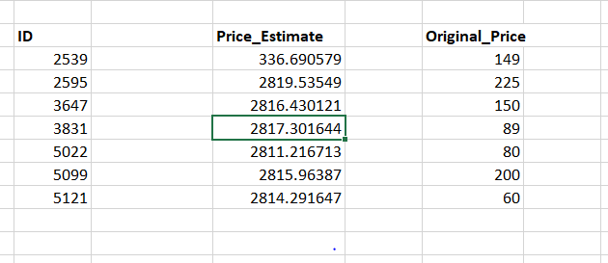
PREDICTION
PREDICTION
Comparing Price Estimate with Original Price
Multiple R-squared: 0.0877, Adjusted R-squared: 0.08743

Slide 25
CONCLUSION
10 variables were used in the multiple linear models to fit the dataset.
Estimated price and original price do not match.
Hence, the price cannot be accurately predicted based on these factors only.

Slide 26
THANK YOU!
Ajay Acharya Kanagala, Jinee Hasmukhbh Patel, Rumana Myageri, Quyen Tuan Ngo

